Slide 1
期末报告
22210180053
黄珂玮

Slide 2
01
NMDS_coordinates.csv

Slide 3
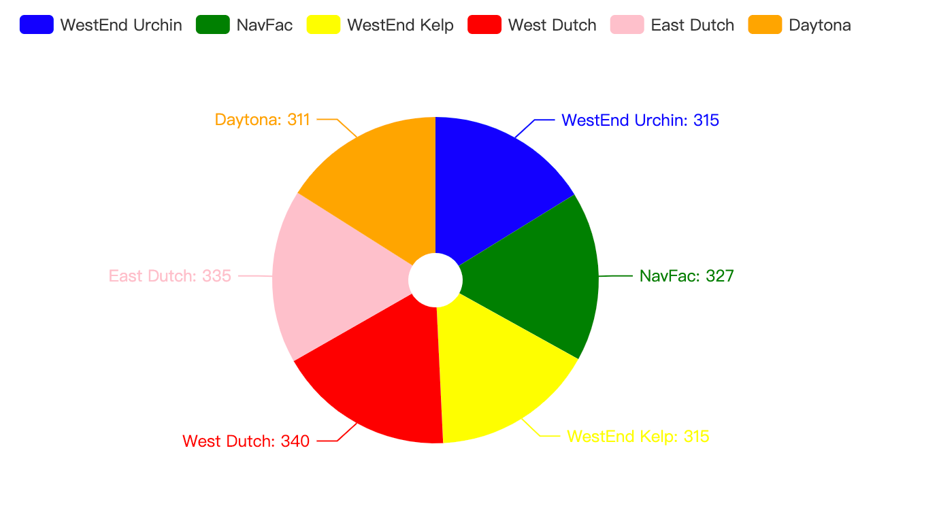
1. Python高级作图(Pyecharts库)
NMDS_df[‘SITE‘]共有6类，按类计算大小，通过饼图展示。

Slide 4
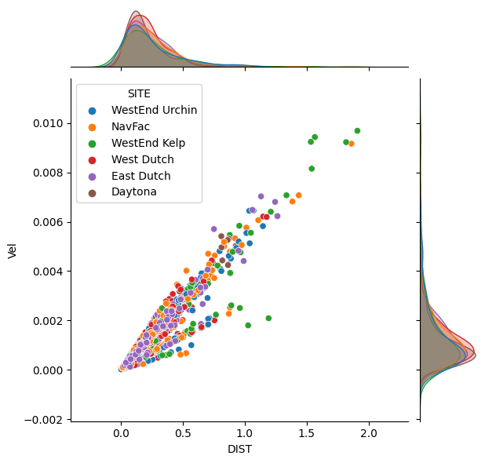
2. Python高级作图(Seaborn库)
NMDS_df[‘Vel‘]和NMDS_df[‘DIST’]联合分布、边缘分布

Slide 5
Python Scikit-learn库
变量：
["PatMin","MegUnd","DerImb","PisGig","PycHel","SteOsm","LamSpp","MacJuv","LamJuv","EisArb","PteCal","MacPyr","mean_rug","sd_rug","se_rug","X_dist","date_diff","days","Vel","X_Vel","MidPt","DIST"]
分类对象：
[‘SITE’]
评价指标：
kappa计算结果为-1~1，但通常kappa是落在 0~1 间，可分为五组来表示不同级别的一致性：0.0~0.20极低的一致性(slight)、0.21~0.40一般的一致性(fair)、0.41~0.60 中等的一致性(moderate)、0.61~0.80 高度的一致性(substantial)和0.81~1几乎完全一致(almost perfect)。
Hamming距离： 越小分类结果越好

Slide 6
3. Python Scikit-learn库10—支持向量机(分类、回归和异常检测、核函数)
kappa:0.7456656592969619,ham_distance:0.21025641025641026
4. Python Scikit-learn库7— Logistic回归、广义线性回归
kappa:0.5715923201833986,ham_distance:0.35384615384615387
5. Python Scikit-learn库11—随机梯度下降(分类、回归)
kappa:0.5635383499889663,ham_distance:0.3641025641025641

Slide 7
6. Python Scikit-learn库12 —最近邻(分类、回归) NearestNeighbors, KDTree, BallTree, NearestCentroid, KNeighborsClassifier
kappa:0.674718506399769,ham_distance:0.26666666666666666
7. Python Scikit-learn库14—偏最小二乘法(PLS)和 典型相关分析(CCA)
kappa:0.5273481103492266,ham_distance:0.38974358974358975
8. Python Scikit-learn库17—聚类(K-means, KMedians, K-medoids,谱聚类, 层次聚类, DBSCAN, 高 斯混合模型GMM) 最小二乘等)
kappa:0.4419764134360318,ham_distance:0.4639175257731959

Slide 8
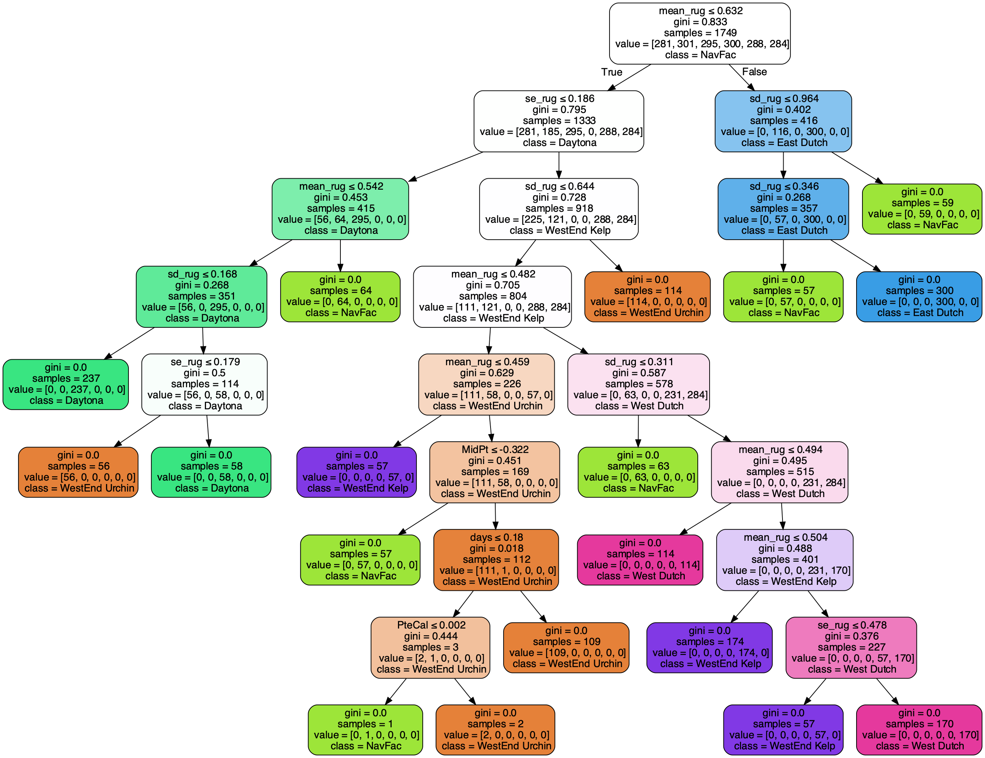
9. Python Scikit-learn库15 —决策树(分类、回归) ID3、C4.5、C5.0和CART

Slide 9
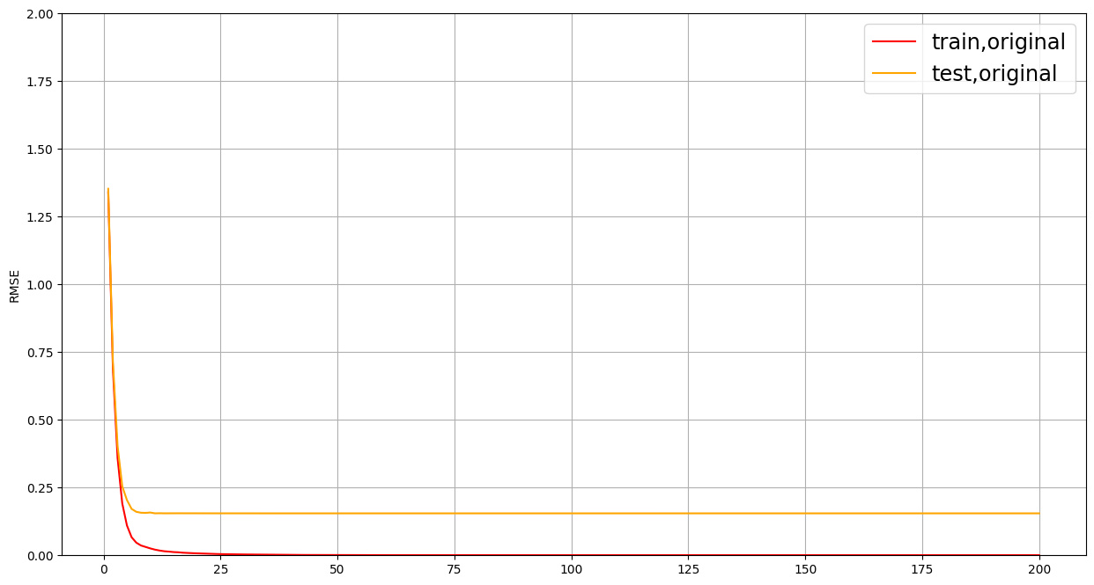
10. Python的XGBoost库(GradientBoosting的优化版)
XGBoost最佳分数：-0.005628018693781524

Slide 10
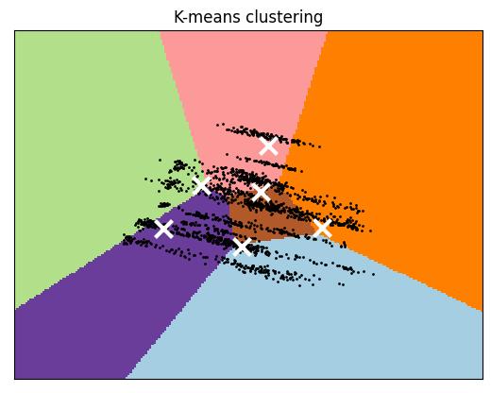
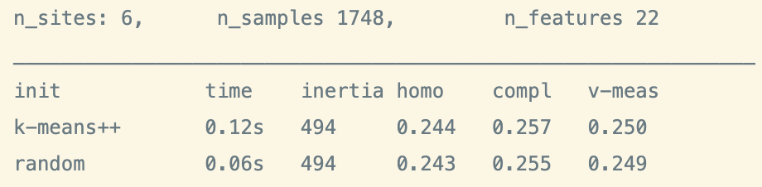
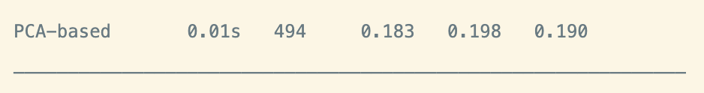
11. Python Scikit-learn库17—聚类(K-means, KMedians, K-medoids,谱聚类, 层次聚类, DBSCAN, 高 斯混合模型GMM) 最小二乘等)

Slide 11
12. Python Scikit-learn库2—Lasso、 MultiTaskLasso(多任务Lasso)
X：["PatMin","MegUnd","DerImb","PisGig","PycHel","SteOsm","LamSpp","MacJuv","LamJuv","EisArb","PteCal","MacPyr","mean_rug","sd_rug","se_rug","X_dist","date_diff","days","Vel","X_Vel","MidPt"]
Y:["DIST"]
对应回归系数：
PatMin:-0.0 MegUnd:0.0 DerImb:0.0 PisGig:-0.0 PycHel:-0.0 SteOsm:0.0 LamSpp:0.0 MacJuv:0.0 LamJuv:0.0 EisArb:0.0 PteCal:0.0 MacPyr:0.0 mean_rug:-0.0 sd_rug:-0.0 se_rug:-0.0 X_dist:-0.0 date_diff:0.0 days:0.0 Vel:0.041462483539836045 X_Vel:-0.0 MidPt:-0.0

Slide 12
13. Python Scikit-learn库2—Lasso、 MultiTaskLasso(多任务Lasso)
X：["PatMin","MegUnd","DerImb","PisGig","PycHel","SteOsm","LamSpp","MacJuv","LamJuv","EisArb","PteCal","MacPyr","mean_rug","sd_rug","se_rug","X_dist","date_diff","days","Vel","X_Vel","MidPt"]
Y:["DIST"]
对应回归系数：
PatMin:-0.0 MegUnd:0.0 DerImb:0.0 PisGig:-0.0 PycHel:-0.0 SteOsm:0.0 LamSpp:0.0 MacJuv:0.0 LamJuv:0.0 EisArb:0.0 PteCal:0.0 MacPyr:0.0 mean_rug:-0.0 sd_rug:-0.0 se_rug:-0.0 X_dist:-0.0 date_diff:0.0 days:0.0 Vel:0.041462483539836045 X_Vel:-0.0 MidPt:-0.0

Slide 13
14. Python Scikit-learn库3—弹性网络ElasticNet 、 MultiTaskElasticNet (多任务弹性网络)
PatMin:-0.0
MegUnd:0.0
DerImb:-0.00924851188688369
PisGig:0.0
PycHel:0.0
SteOsm:0.0
LamSpp:-0.0
MacJuv:0.01201016148844581
LamJuv:0.04282654975025193
mean_rug:-0.0
sd_rug:-0.002675061151069189
se_rug:-0.00032089434655666114
X_dist:-0.0
date_diff:0.10896653698450141
days:0.09625325850901247
Vel:0.9132481901517199
X_Vel:0.0006789043008156008
MidPt:2.063713881993624e-05

Slide 14
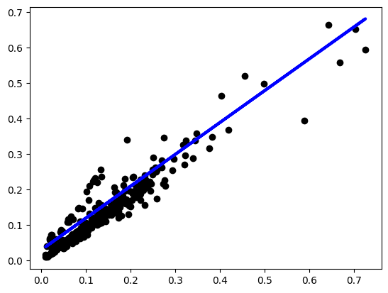
15. Python Scikit-learn库5—贝叶斯回归(贝叶斯岭回归、自动关联判定-ARD)
'C': 0.2, 'epsilon': 0.01, 'loss': 'squared_epsilon_insensitive', 'max_iter': 80000, 'tol': 0.01} 0.8770152648592223
X: "Vel"
Y: ”DIST”
SITE == East Dutch

Slide 15
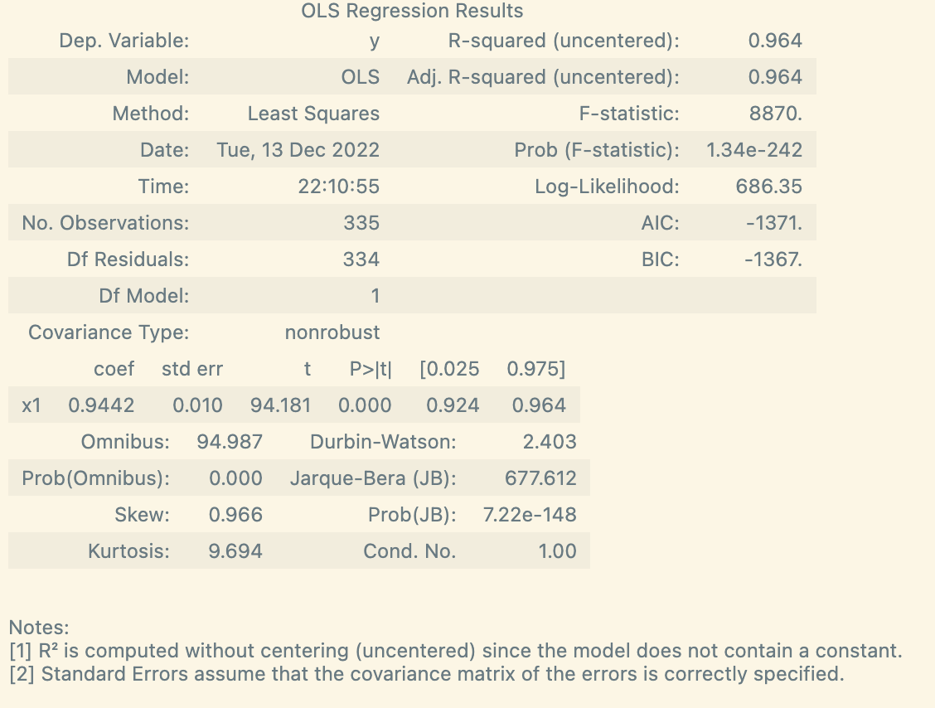
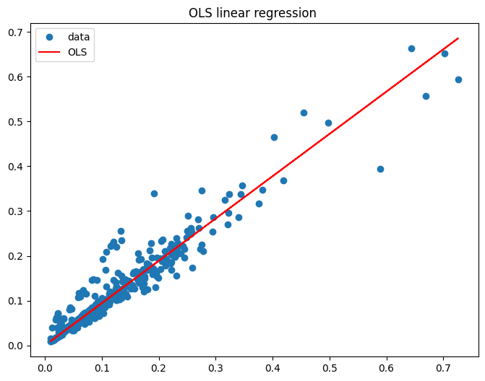
16. Python统计建模和计量经济学工具包(Statsmodels)
X: "Vel"
Y: ”DIST”
SITE == East Dutch

Slide 16
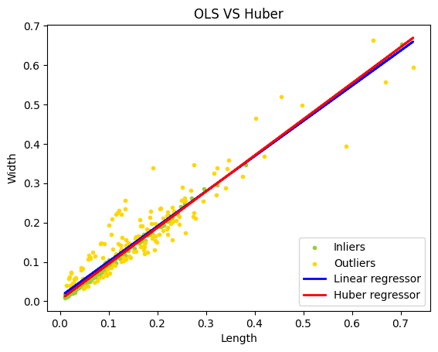
17. Scikit-learn库9—鲁棒回归：离群(outliers) 与模型错误、多项式回归
X: "Vel"
Y: ”DIST”
SITE == East Dutch

Slide 17
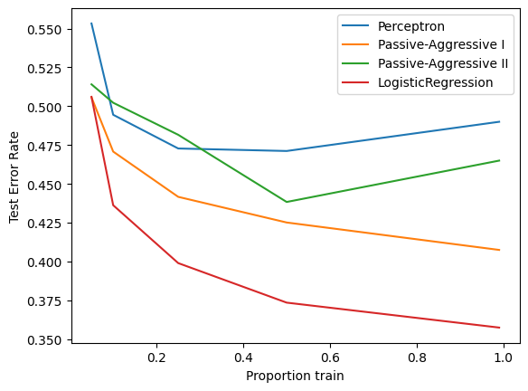
18. Scikit-learn库8—感知机、被动感知算法
X=["PatMin","MegUnd","DerImb","PisGig","PycHel","SteOsm","LamSpp","MacJuv","LamJuv","EisArb","PteCal","MacPyr","mean_rug","sd_rug","se_rug","X_dist","date_diff","days","Vel","X_Vel","MidPt","DIST"]
Y=['SITE']

Slide 18
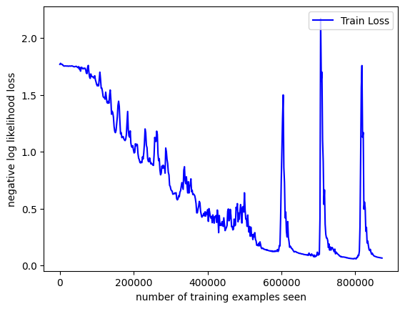
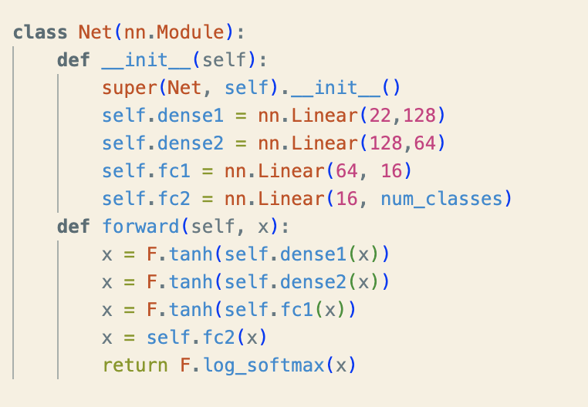
19. PyTorch库(机器学习)
通过["PatMin","MegUnd","DerImb","PisGig","PycHel","SteOsm","LamSpp","MacJuv","LamJuv","EisArb","PteCal","MacPyr","mean_rug","sd_rug","se_rug","X_dist","date_diff","days","Vel","X_Vel","MidPt","DIST"]
使用简单全连接层模型，对[‘SITE’]进行分类
输入：[batch_size,feature]
输出：[batch_size,num_classes]

Slide 19
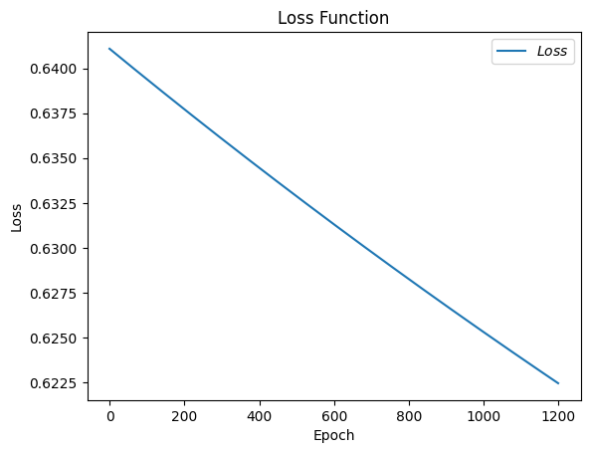
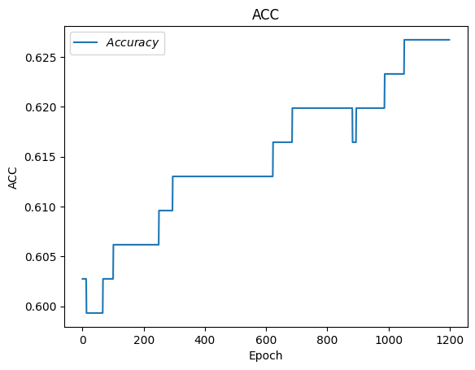
20. Python: tensorflow (人工智能学习系统)
21. Python关于时间日期的操作
简单全连接层模型
训练：Time span: 0:03:22.056039

Slide 20
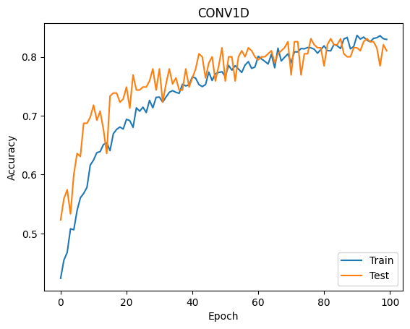
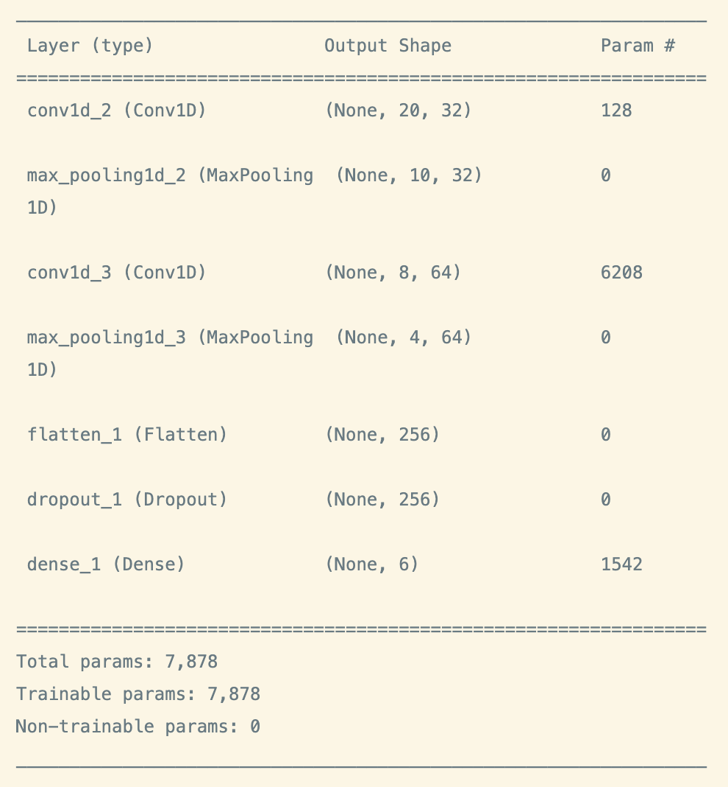
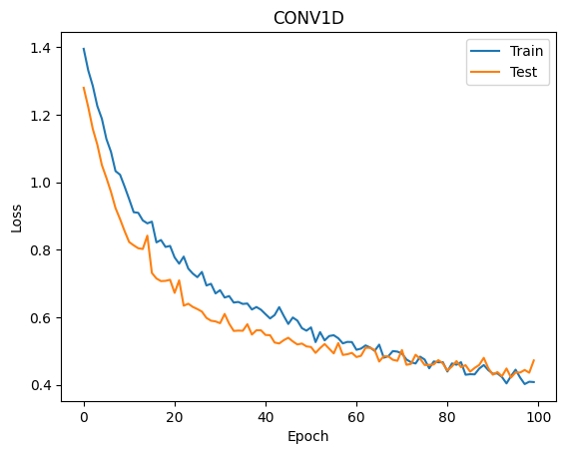
22. Python: keras等(神经网络)
卷积模型

Slide 21
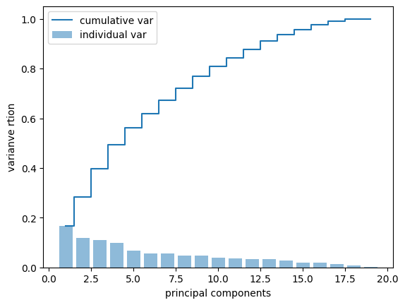
23. Python主成分分析、因子分析、关联规则分析 (apriori)
X = ["PatMin","MegUnd","DerImb","PisGig","PycHel","SteOsm","LamSpp","MacJuv","LamJuv","EisArb","PteCal","MacPyr","mean_rug","sd_rug","se_rug","X_dist","date_diff","days","Vel","X_Vel","MidPt"]

Slide 22
24. 预处理(特征提取和归一化): 转换输入数据，以供机器学习算法使用
使用onehot编码标签向量：
enc = preprocessing.OneHotEncoder()
y_test_ = enc.fit(y_test.reshape(-1,1))
结果：
Test loss: 0.6301332712173462
Test accuracy: 0.764102578163147

Slide 23
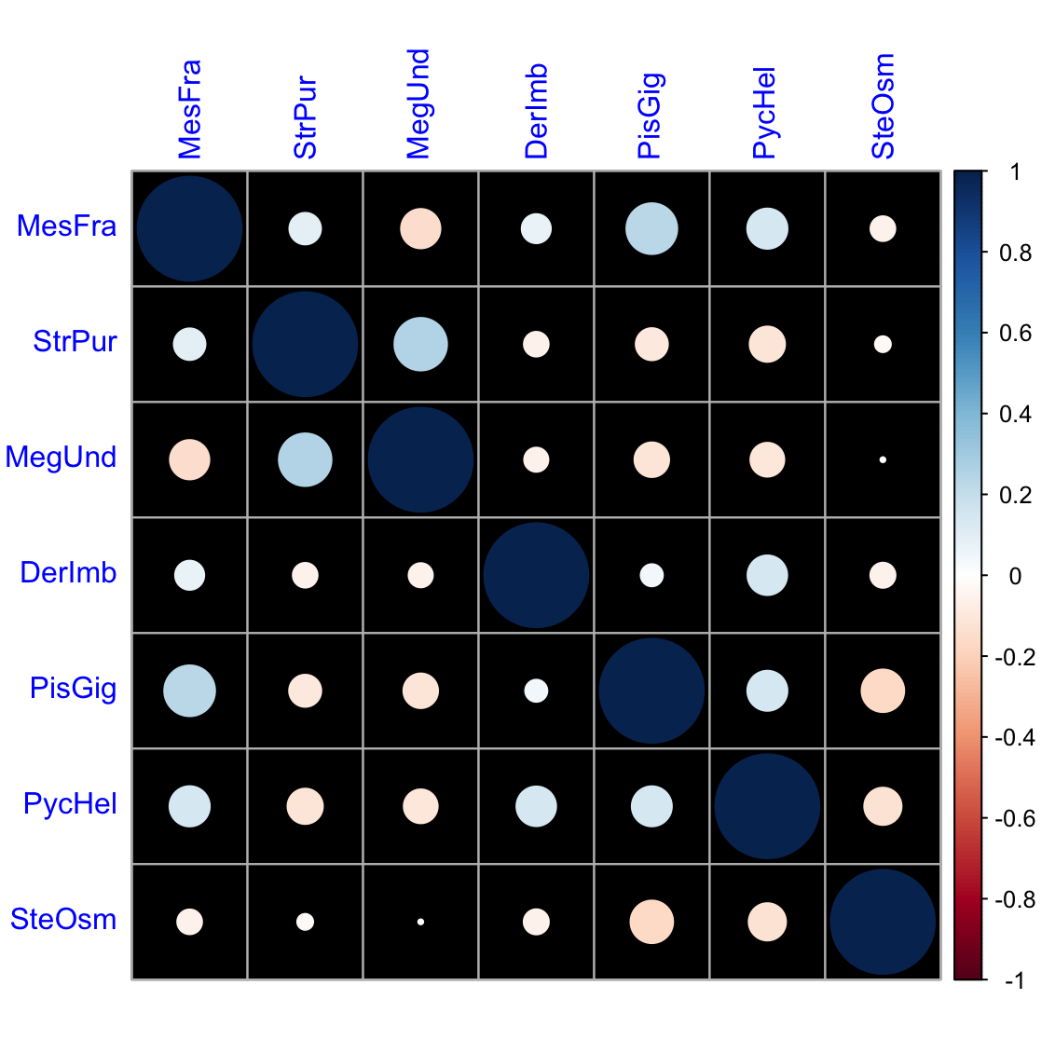
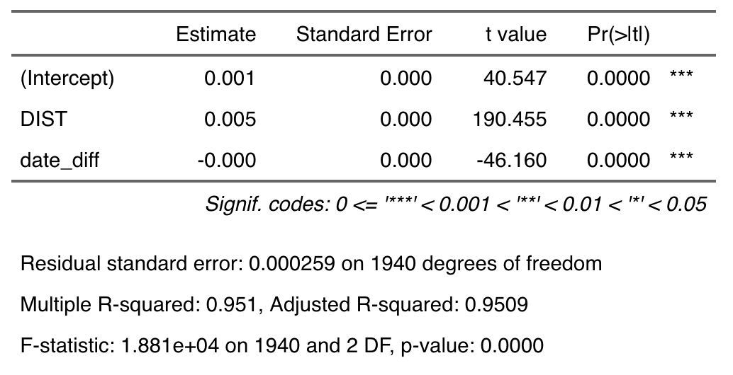
25. R基本的回归分析(线性回归的回归诊断：线性性 、独立性、正态性）
Vel ~ DIST+se_rug+date_diff

Slide 24
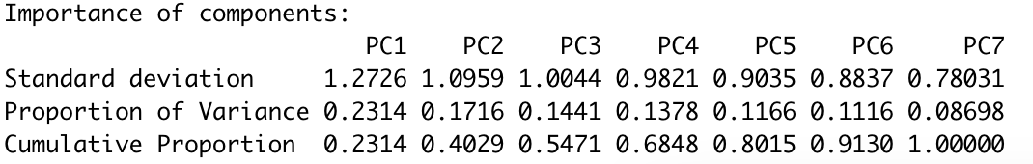
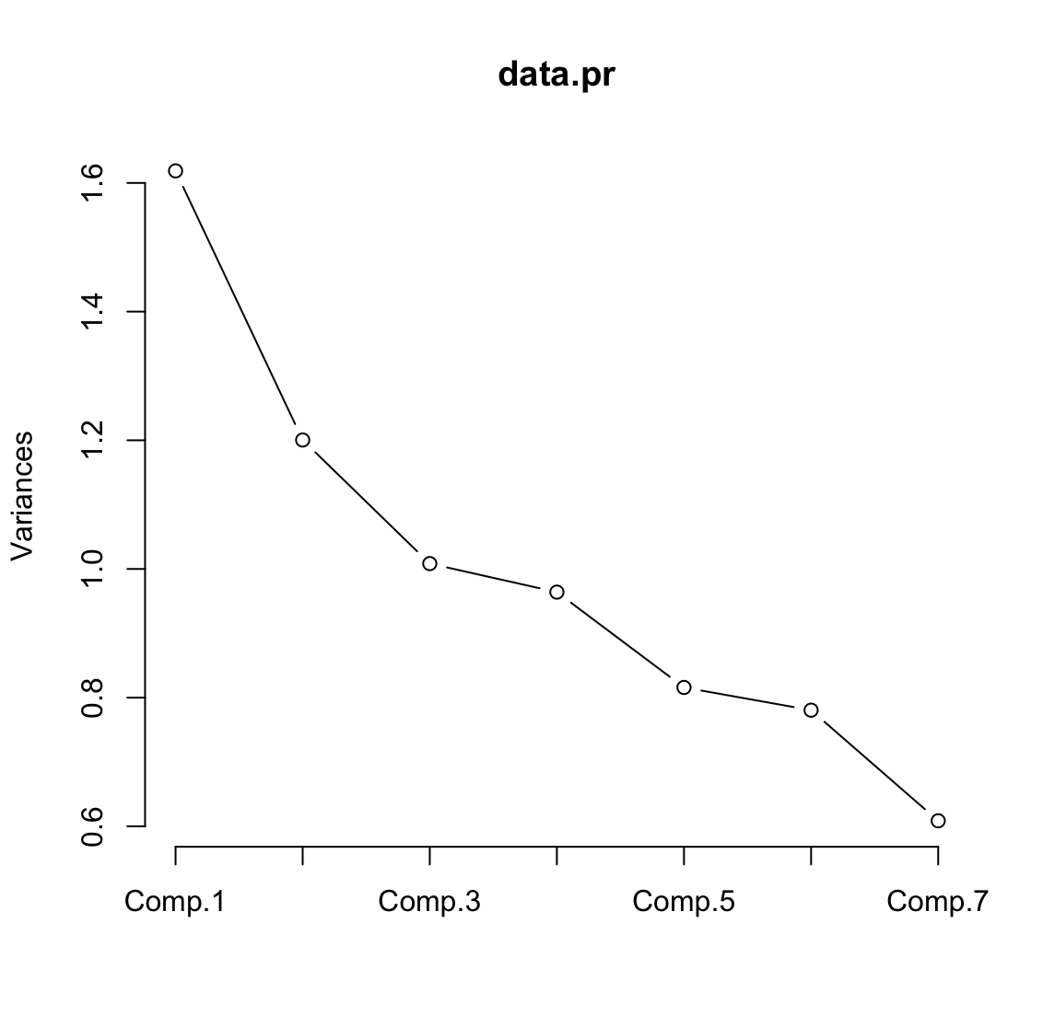
26. R主成分分析

Slide 25
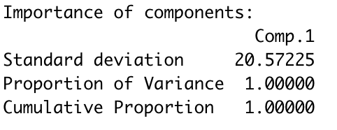
27.主成分回归、偏最小二乘回归(处理多重共线性)(pls库)

Slide 26
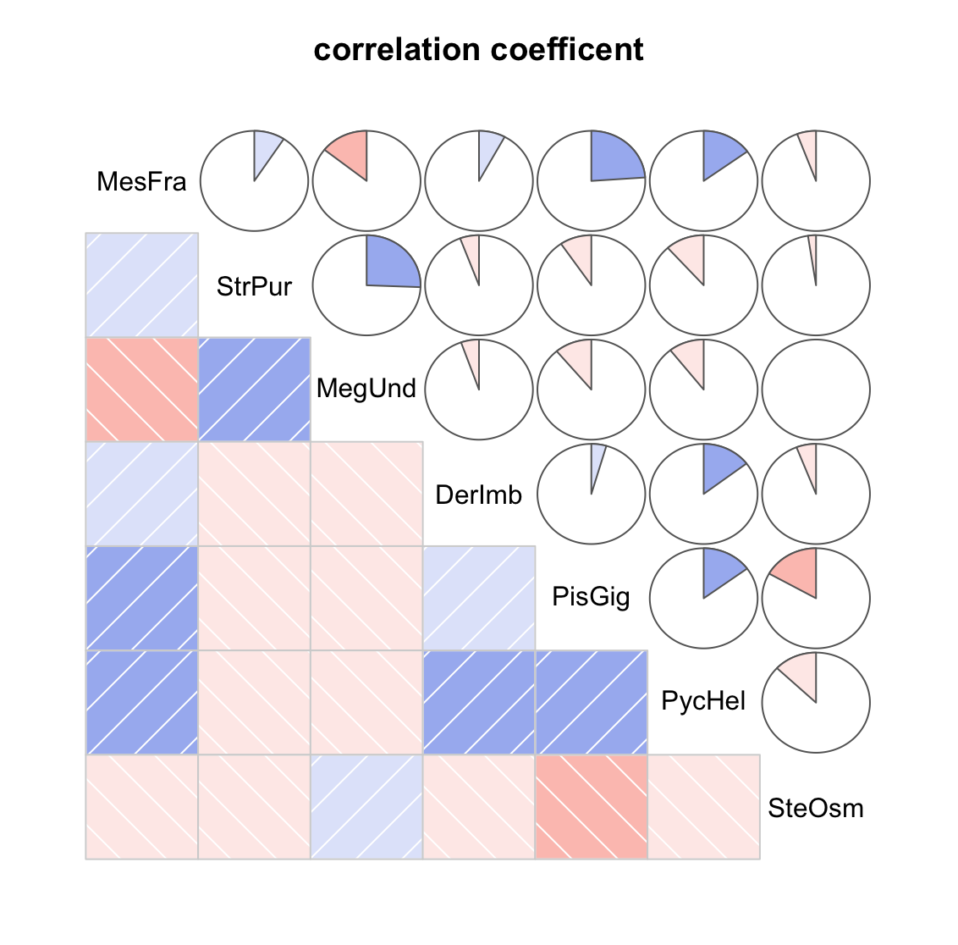
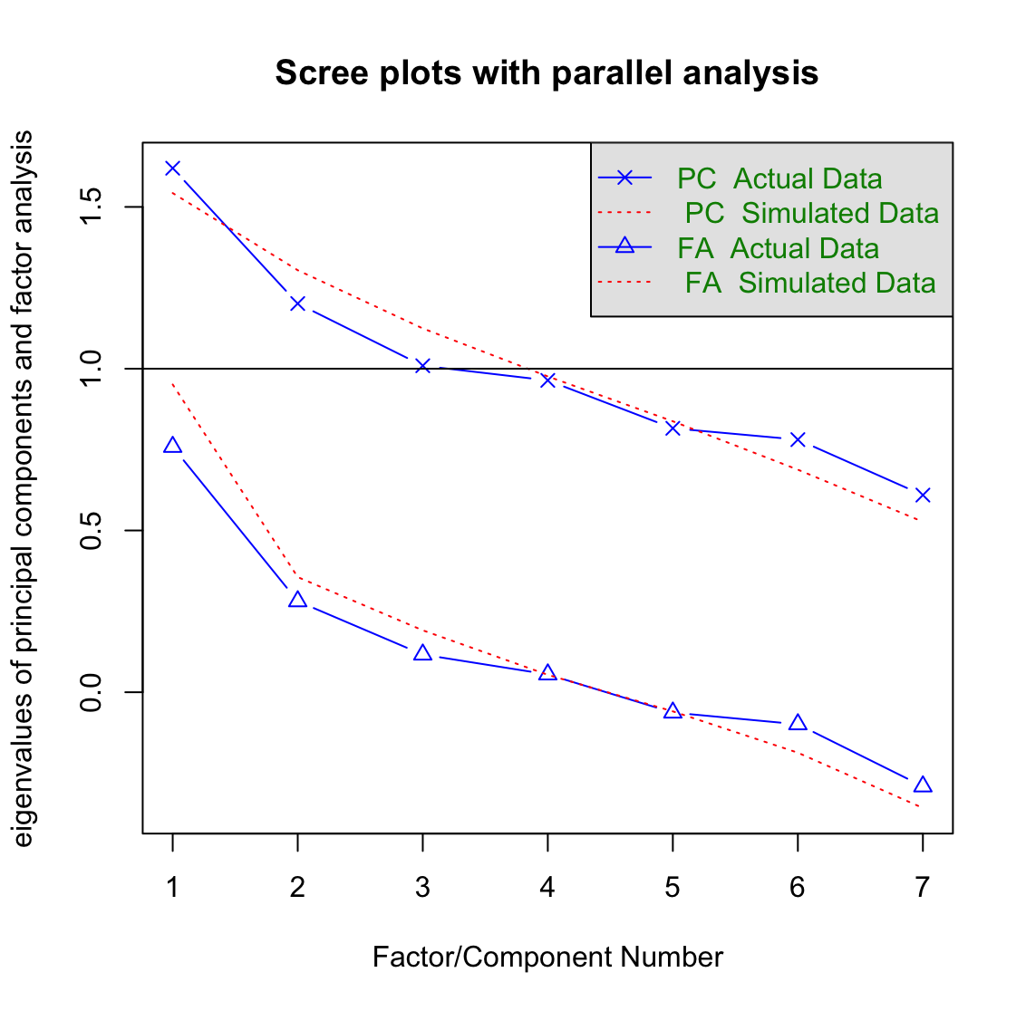
28. R因子分析

Slide 27
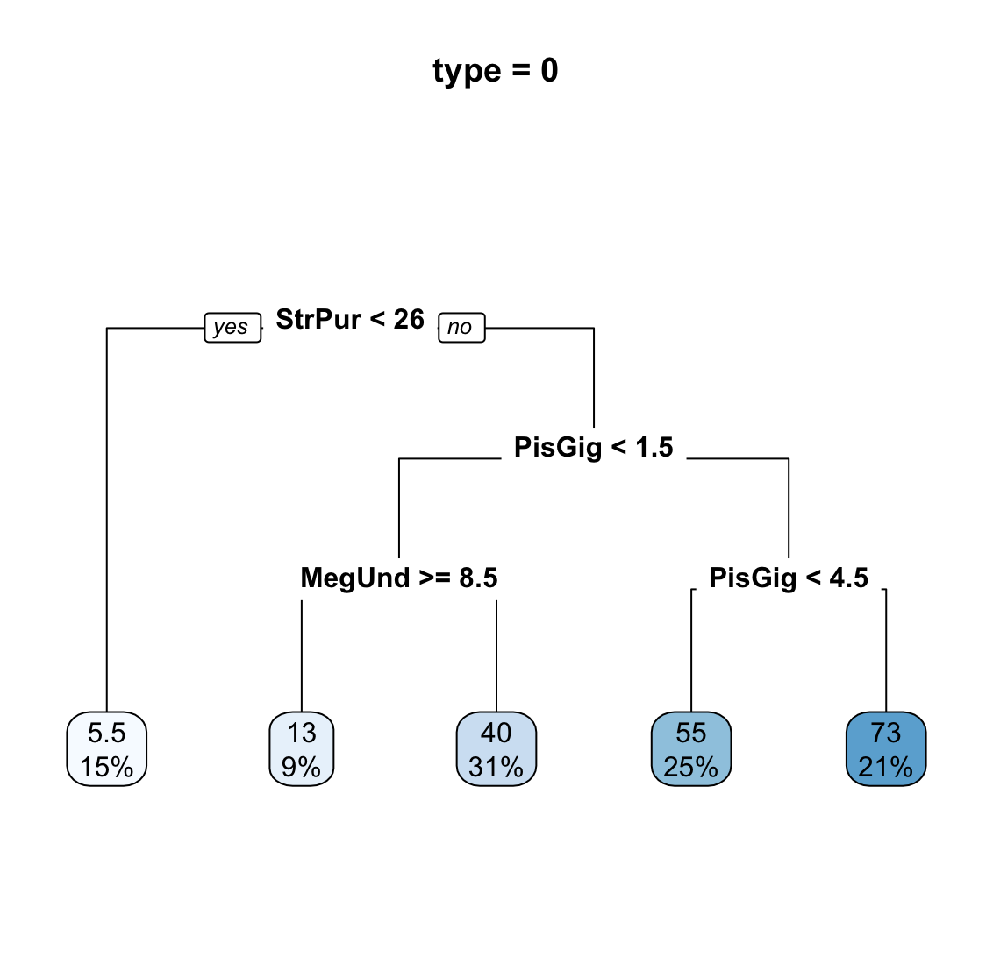
29. R决策树

Slide 28
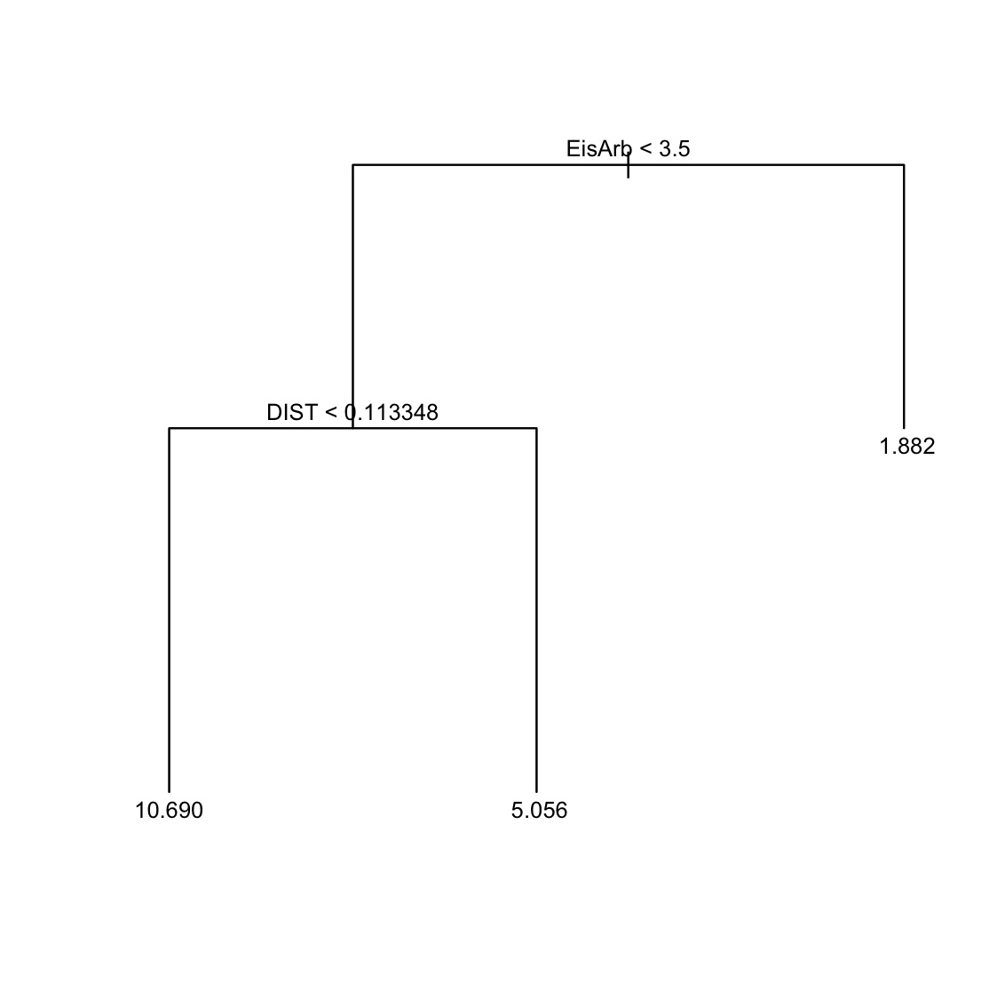
30. R boosting回归、bagging回归

Slide 29
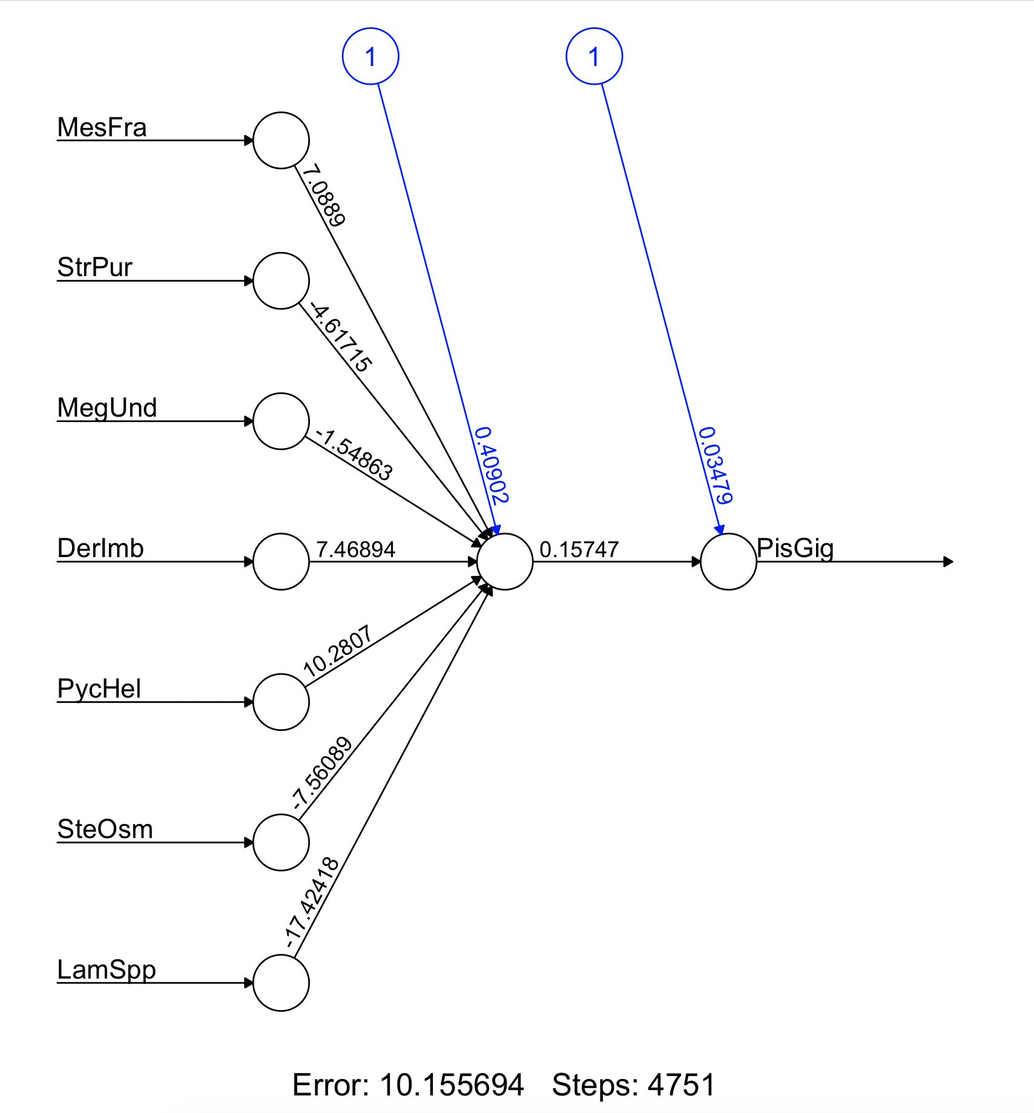
31. R神经网络

Slide 30
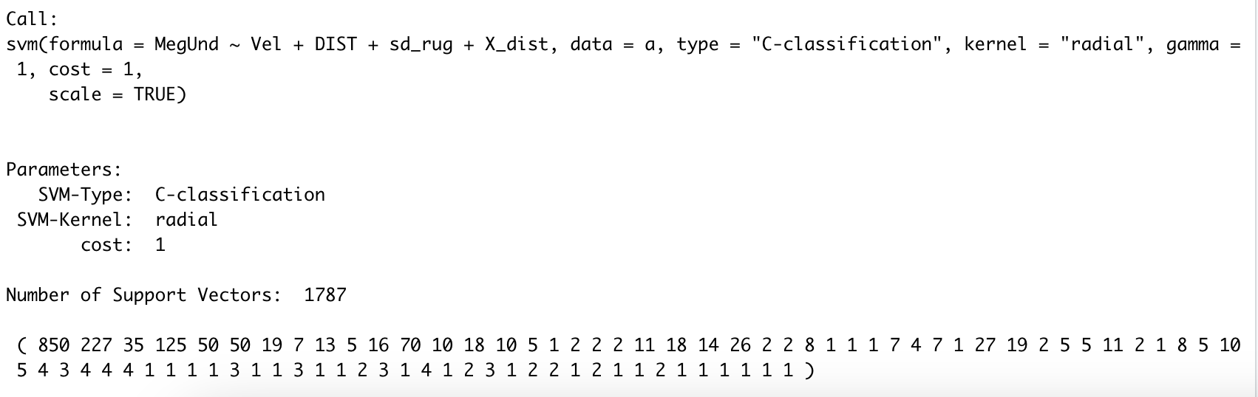
32. R支持向量机
MegUnd ~ Vel + DIST + sd_rug + X_dist

Slide 31
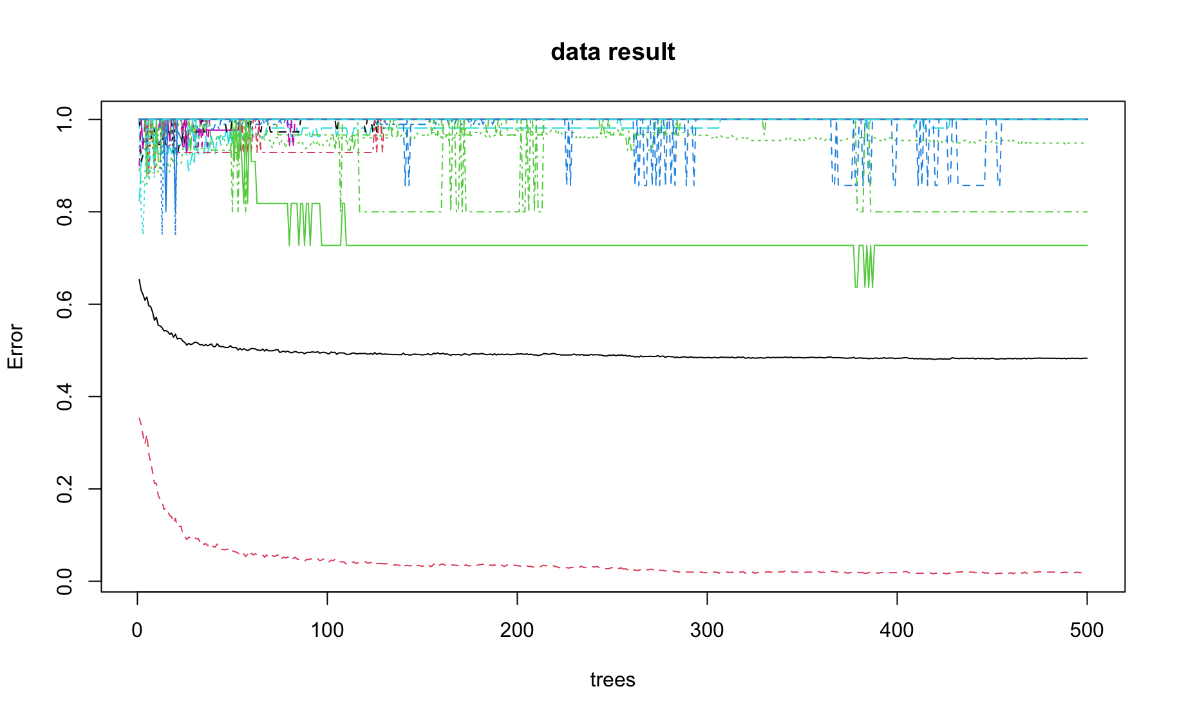
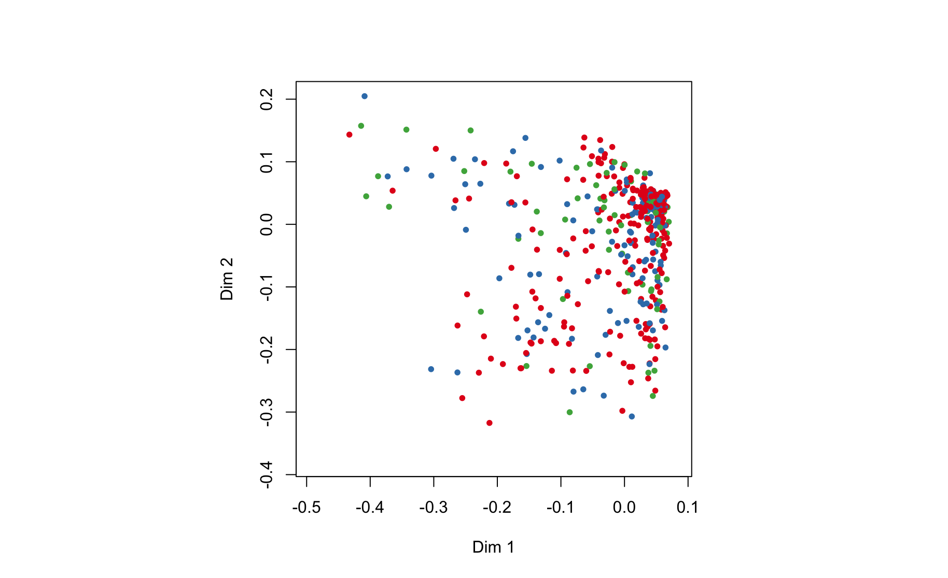
33.随机森林

Slide 32
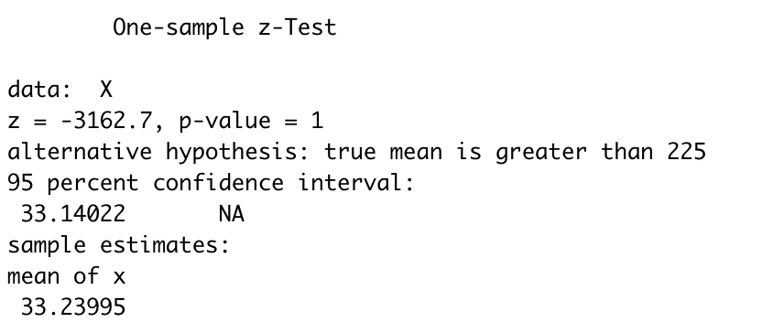
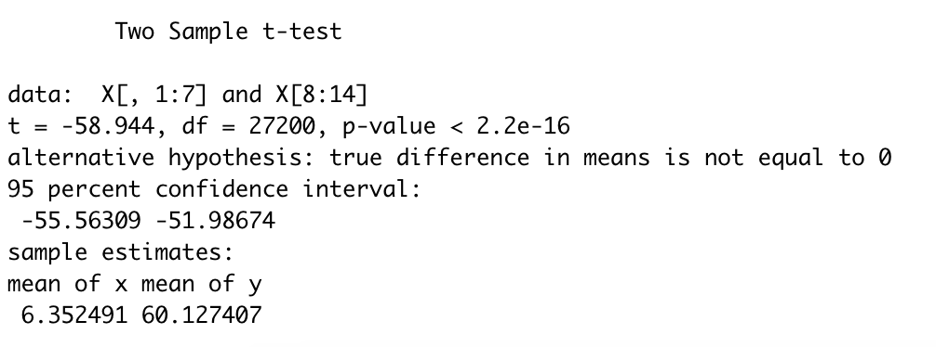
34.用R作假设检验(均值检验、方差检验、非参数检验)

Slide 33
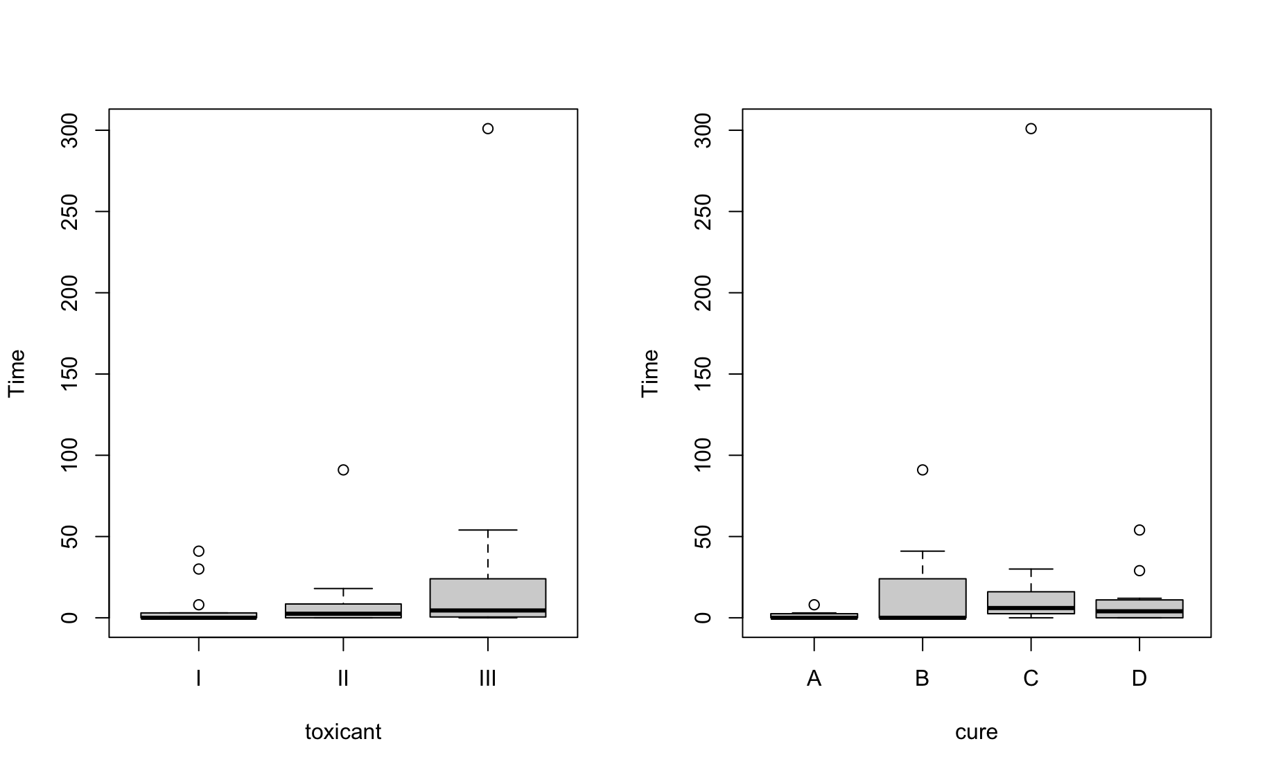
35. R方差分析(单因素、双因素)
PisGig ~ MesFra + StrPur + MegUnd + DerImb + PycHel + SteOsm + LamSpp

Slide 34
02
ABS_RFP.txt

Slide 35
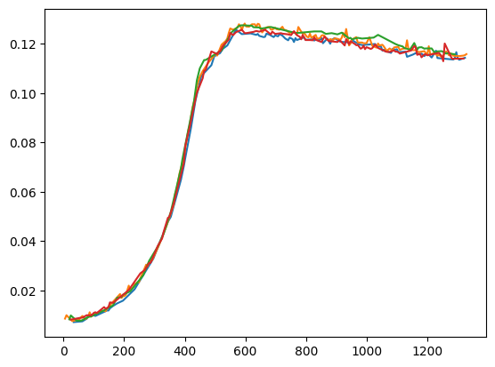
36. Python基本作图 matplotlib
绘制五根曲线

Slide 36
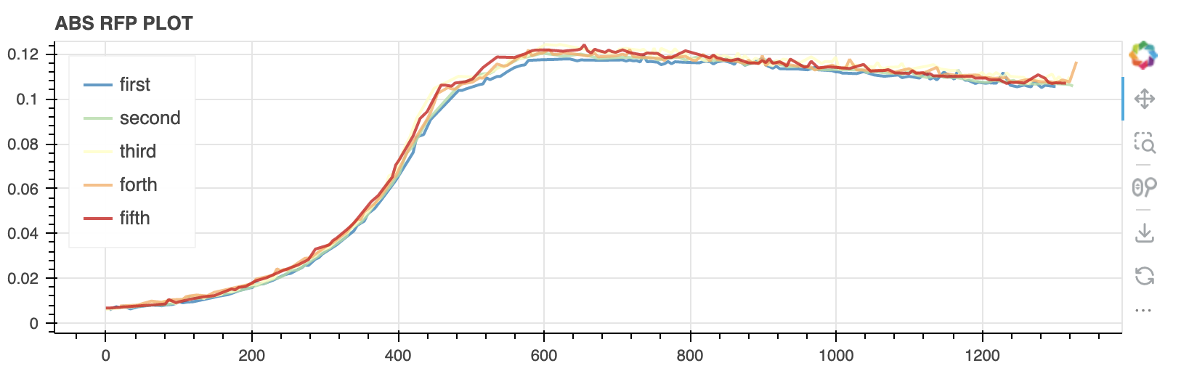
37. Python高级作图(Bokeh等库)

Slide 37
03
WaveHeights.csv

Slide 38
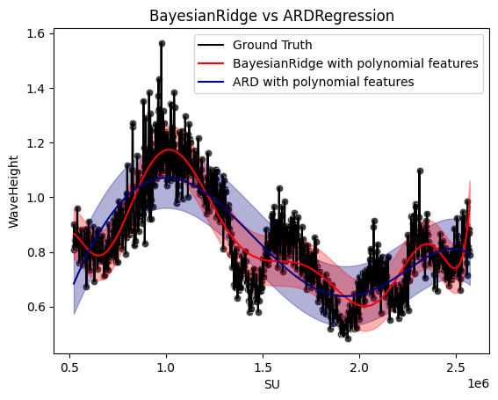
38. Python高级作图(Seaborn库)

Slide 39
04
zone_c_confirmesGeo.csv

Slide 40
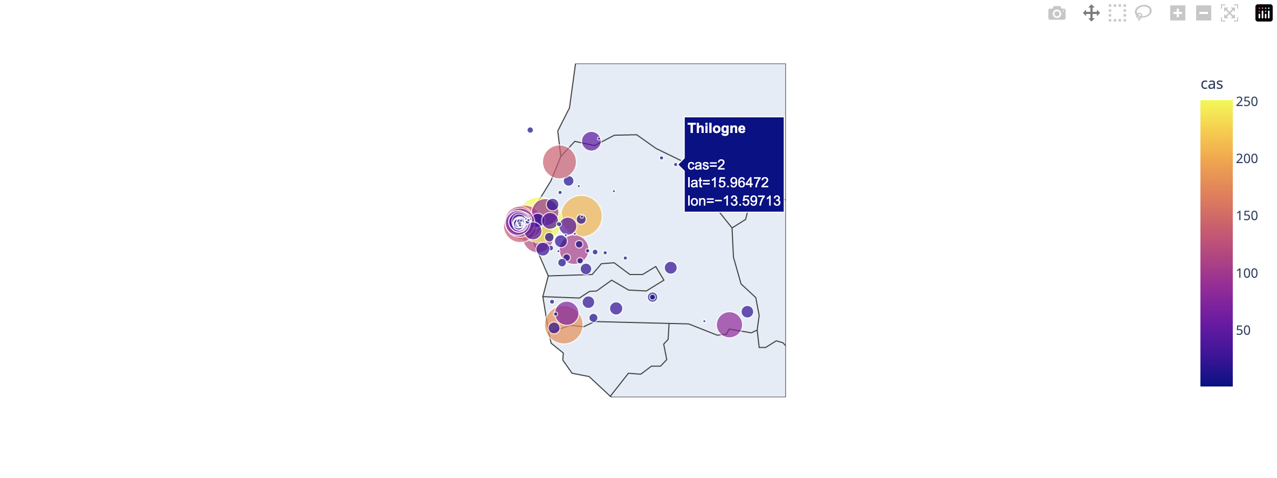
39. Python高级作图(Plotly等库)

Slide 41
04
小说.txt

Slide 42
40. Selenium库
继续爬取相关页面小说文字：
“Notice”
A warning is given to the reader by the author.
“Chapter 1”
The outcome of Huck and Tom's previous adventures are revealed. Widow Douglas' attempts to civilize Huck.
“Chapter 2”
Huck plays a trick on Jim in order to avoid getting caught sneaking out. Huck joins Tom Sawyer's gang.
…

Slide 43

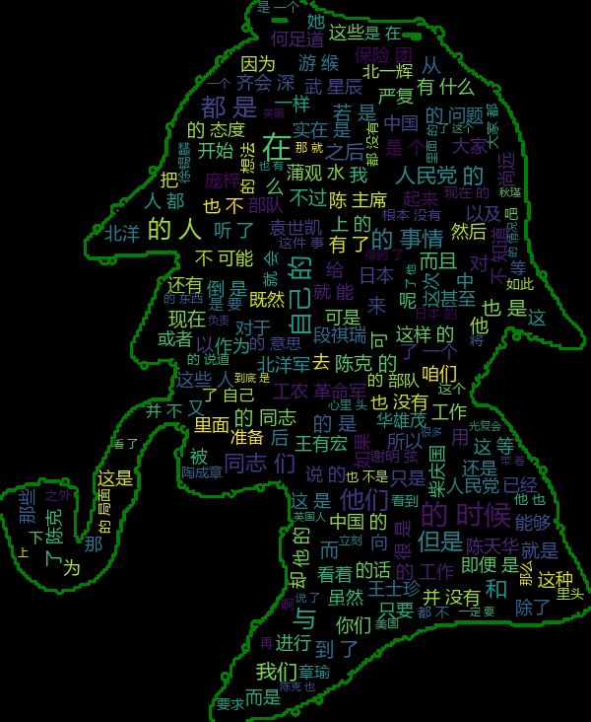
41. Python词云(wordcloud库等)

Slide 44
42. Python自然语言处理: (jieba库)
['陈克', '赤色', '黎明', '之影', '观礼台', '冉冉升起', '不眠之夜', '五星红旗', '熬过', '天际’]
['赤色', '能够', '时候', '工作', '等待', '染上', '红色', '太阳', '伴随', '黑夜’]
[('陈克', 0.8983905518105264), ('赤色', 0.3777257345964912), ('黎明', 0.281408584757193), ('之影', 0.2124371611), ('观礼台', 0.2124371611), ('冉冉升起', 0.19522963034561405), ('不眠之夜', 0.1931632613), ('五星红旗', 0.1860498383508772), ('熬过', 0.17388936149842107), ('天际', 0.17118496360666666)]
[('赤色', 1.0), ('能够', 0.9977554461042824), ('时候', 0.9968617702234596), ('工作', 0.9934182365197717), ('等待', 0.9934182365197717), ('染上', 0.7985228409882946), ('红色', 0.7541745835463696), ('太阳', 0.7495641098646791), ('伴随', 0.7436748177726326), ('黑夜', 0.671554833852044)]
['赤色', '观礼台', '天际', '霞光', '染上', '黑夜', '时分', '色彩', '红色', '无法’]
['染上', '霞光', '时候', '赤色', '无法', '时分', '色彩', '世界', '红色’]
['赤色', '观礼台', '天际', '霞光', '染上', '混沌', '鲜艳', '黑夜', '时分', '轻松’]
['染上', '鲜艳', '色彩', '世界', '霞光', '黑夜', '时候', '赤色', '混沌', '无法']

Slide 45
43. Python自然语言处理: (gensim库)
Test Document (85): «the fir tree and the bramble» SIMILAR/DISSIMILAR DOCS PER MODEL Doc2Vec<dm/m,d64,n5,w5,mc4,s0.001,t3>:
MOST (18, 0.6504717469215393): «the pomegranate and apple tree disputed as to which was the most beautiful when their strife was at its height bramble from the neighboring hedge lifted up its voice and said in boastful tone pray my dear friends in my presence at least cease from such vain disputings»
actual:3 (85, 0.606070876121521): «fir tree said boastingly to the bramble you are useful for nothing at all while am everywhere used for roofs and houses the bramble answered you poor creature if you would only call to mind the axes and saws which are about to hew you down you would have reason to wish that you had grown up bramble not fir tree better poverty without care than riches with»
MEDIAN (229, 0.3476870059967041): «the north wind and the sun disputed as to which was the most powerful and agreed that he should be declared the victor who could first strip wayfaring man of his clothes the north wind first tried his power and blew with all his might but the keener his blasts the closer the traveler wrapped his cloak around him until at last resigning all hope of victory the wind called upon the sun to see what he could do the sun suddenly shone out with all his warmth the traveler no sooner felt his genial rays than he took off one garment after another and at last fairly overcome with heat undressed and bathed in stream that lay in his path persuasion is better than force»

Slide 46
04
confirmes.csv

Slide 47
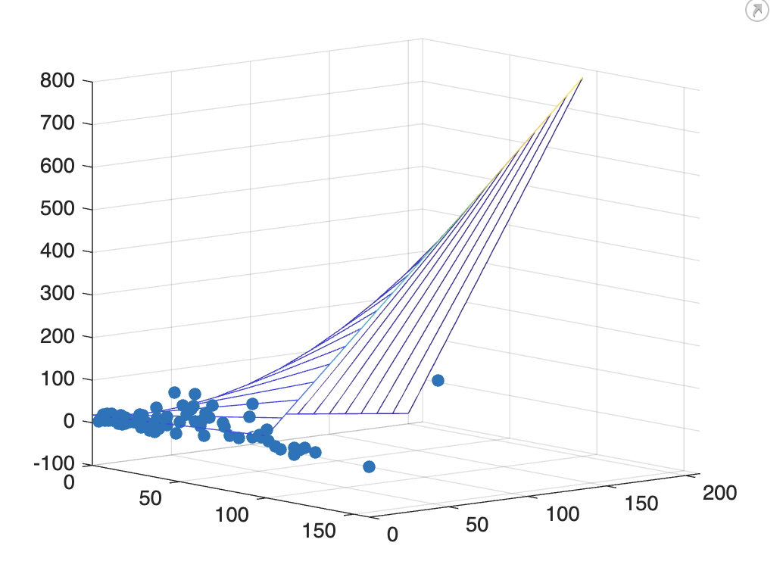
44. MATLAB线性回归、 广义线性回归 (glmfit函数)
x1 = M(:,2); %定义自变量
x2 = M(:,3); % 定义自变量（含空值）
y = M(:,4);

Slide 48
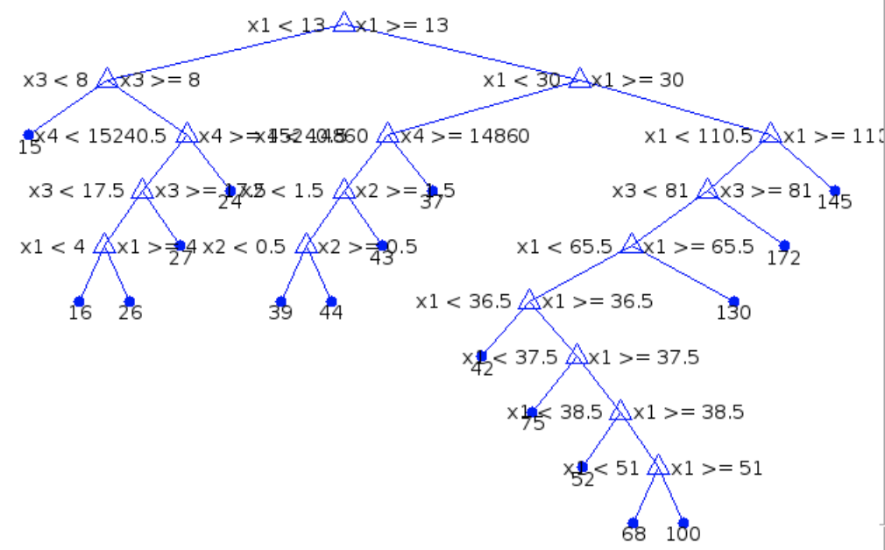
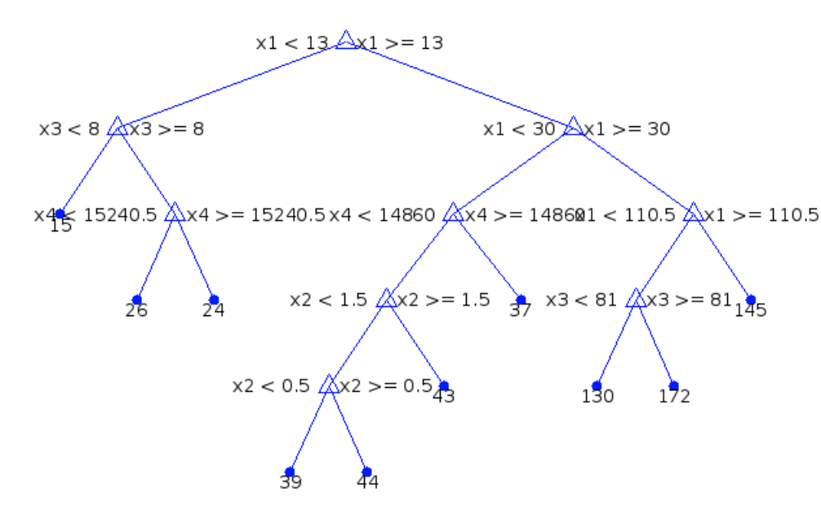
45. MATLAB 决策树
修剪后的图
原图

